Slide 1
Innovative Monitoring System for TeleICU Patient Using Video Processing & Deep Learning -SUBHAM SRIVASTAVA (Manipal Institute Of Technology)

Slide 2
UNIQUE IDEA:
Under the TeleICU project, it primarily focuses on improving remote patient monitoring in ICUs with cutting-edge computer vision. In the wake of this, YOLOv8 is deployed to automatically identify and track patients' behavioral activities through an efficient real-time object detection model for improved remote monitoring by health experts. This goes a long way to ensuring better response times and outcome for patients at the same time. TeleICU by YOLOv8, this brings along better efficiency and effectiveness of critical care being delivered remotely.

Slide 3
PROCESS FLOW:
DATASET COLLECTION AND PREPROCESSING
OBJECT DETECTION USING YOLOV8
BUILDING A MOTION DETECTION ALGORITHM
OPTIMIZING MODEL BY EXPORTING IT TO
(.engine) MODEL USING TENSORRT
API INTERFACING USING FLASK

Slide 4
WORKING:
OBJECT DETETCTION: For real-time applications within the TeleICU project, fast and accurate detection methods are needed, which can be provided by YOLOv8 in the case of object detection.So we trained an object detection model using YOLOv8 for detecting three classes (patient, medical staff,family) present in any video frame or an image or real time.
MOTION DETECTION SYSTEM: The Motion Detection System automatically turns on when the patient is alone. At this stage, whenever there is a motion detected in the frame above the threshold value, “UNUSUAL MOVEMENT” is displayed on the frame itself.
API INTERFACING: Flask is a very lightweight Python web framework that allows the creation of APIs with minimum hassle. It quickly allows us to set up web services in a way that they handle requests and responses structurally.

Slide 5
TECHNOLOGIES USED:
ULTRALYTICS ( YOLOv8 )
SUPERVISION
OPEN CV
HTML
CSS
ROBOFLOW
TENSORRT
GOOGLE COLAB
VS CODE
FLASK
PYTHON
GITHUB

Slide 6
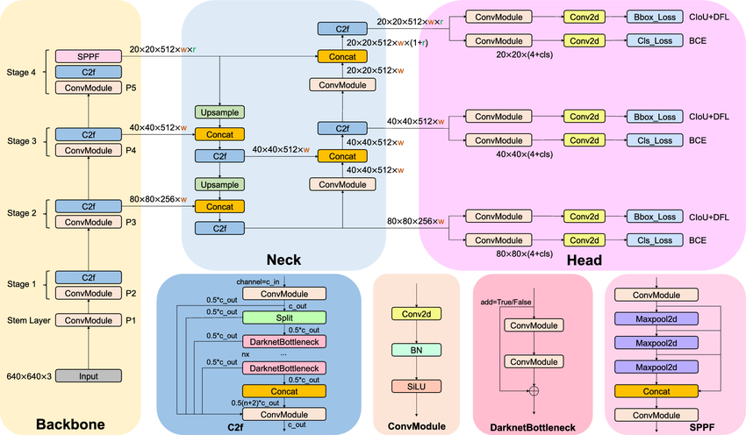
Architecture Diagram ( YOLOv8 )

Slide 7
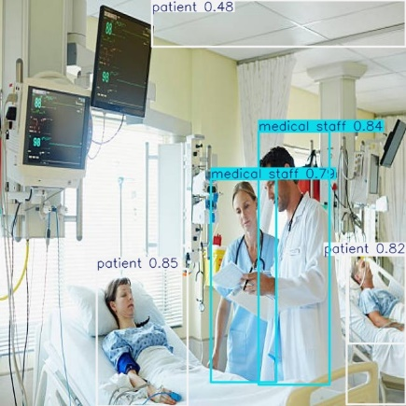
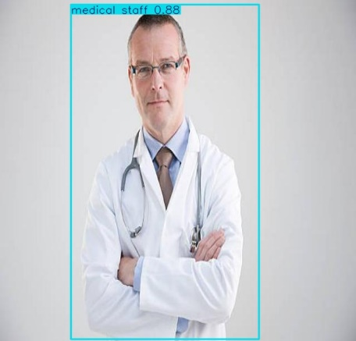
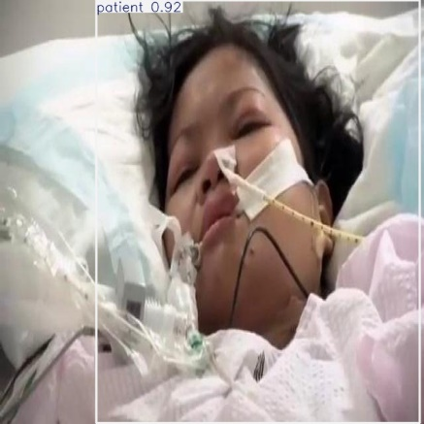
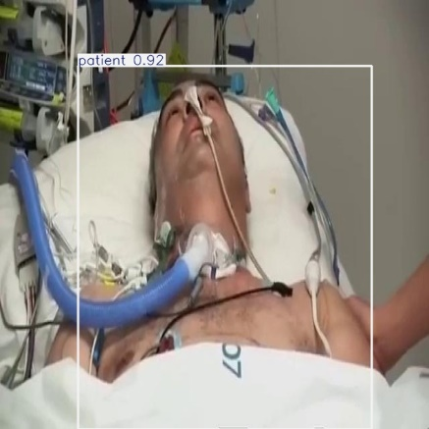
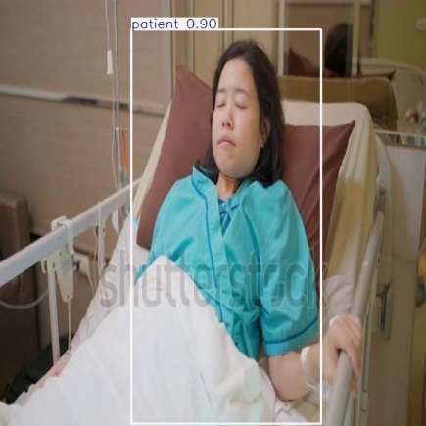
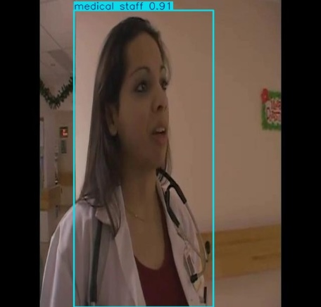
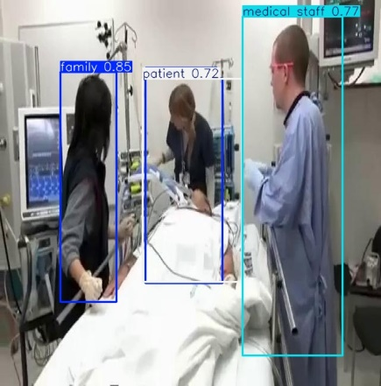
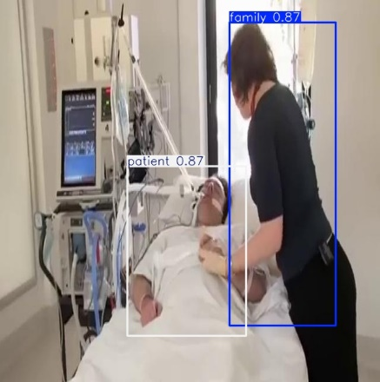
Sample Outputs:

Slide 8
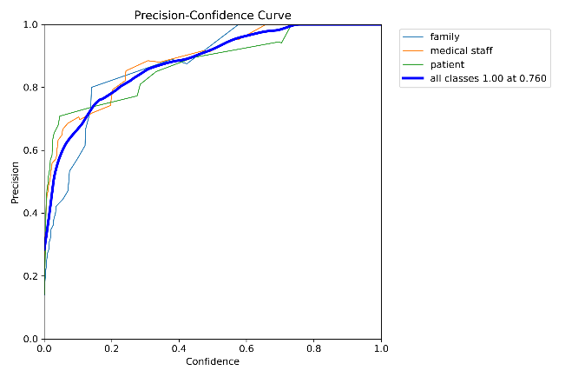
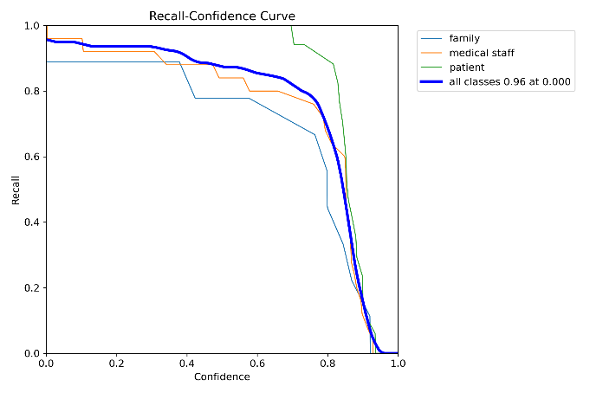
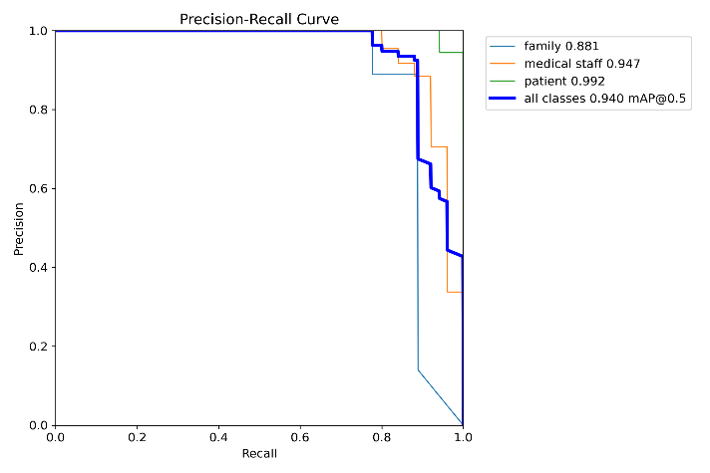
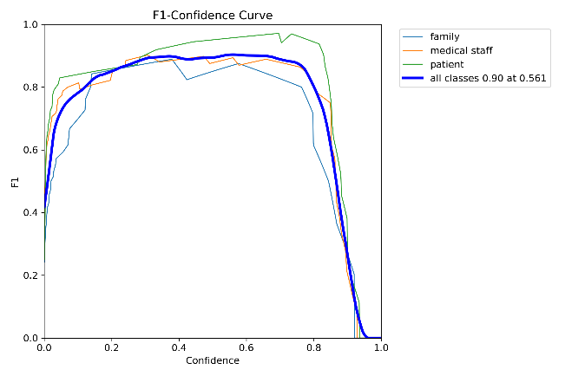
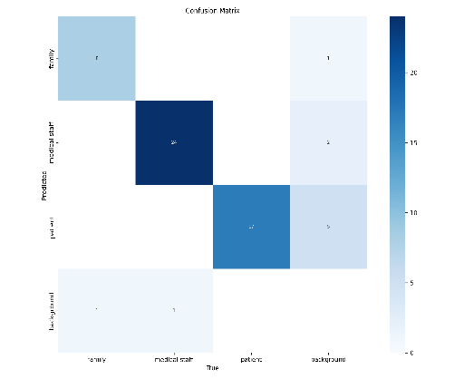
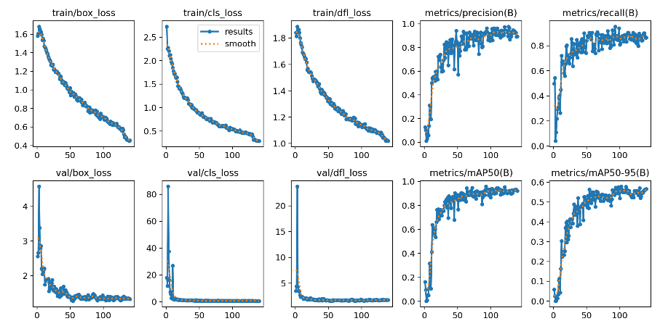
Results Evaluations:

Slide 9
Scope For Improvement:
Model optimization: All domain-specific data fine-tune YOLOv8 continuously for better detection accuracy, especially in diverse ICU environments. Quantization and other optimizations from TensorRT can be further applied to reduce latency and memory usage.
Real-time analytics: Advanced analytics with insight into such trends of patients and equipment usage will enable proactive care and better resource allocation.
User Interface Optimisation: The user interface for health professionals can be made more user-friendly so that quicker decisions can be taken. More intuitive dashboards, visual alerts, and access to real-time data on dashboards will help in the usability of the system.
EMR System Integration: Integration should work seamless with EMR systems. It will provide a smooth workflow to the clinicians by opening charts of patient history and other related data side by side with monitoring.

Slide 10
Team members and contribution:
SUBHAM SRIVASTAVA:
Data Collection, Labelling and Preprocessing
Coding ( training model, motion detection )
API Interfacing
Report
PPT

Slide 11
Conclusion
In conclusion, the YOLOv8-embedded Tele-ICU project is really an advanced version toward remote patient monitoring in critical care. In that, the project will have the ability to generate real-time object detection added to monitor patient's behavior, providing the opportunity for healthcare workers to monitor more accurately and meet the developing needs of the patients. It will lead to better outcomes and time-efficient collaboration will also be realized through the leveling of technological advancement between onsite workers and outside specialists. As telemedicine is revolutionized, the TeleICU Project opens the door to the next generation of answers for solving modern health care dilemmas, creating access to timely, efficient, quality care.

